Slide 1

Sinhgad Technical Education Society’s
Smt. Kashibai Navale College of Engineering
Department of Computer Engineering
Academic Year: 2022-23
Presentation on:- Front-End Developer Internship
GUIDED BY : | PRESENTED BY :
Dr.K.N.Honwadkar | Aneesh Sopan Wath
SKNCOE,Pune | SKNCOE, Pune
 | ROLL NO: C31174

Slide 2
Presentation Content
Introduction of Company
Internship Technology
Problem Statement
Project Objective
Scope of Web Development
Methodological Details
Project Output/Result
Conclusion
Certificate of Internship

Slide 3
Details of Company
Name of Company:
Suven Consultants And Technology Pvt Ltd.
Company Services
Technology training
Higher Education Consulting
Fresher Hiring
Career Building
Internships
Mentorship
Company Website: https://www.suvenconsultants.com/
External mentor: Rocky Jagtiani
Contact Number: 9892544177

Slide 4
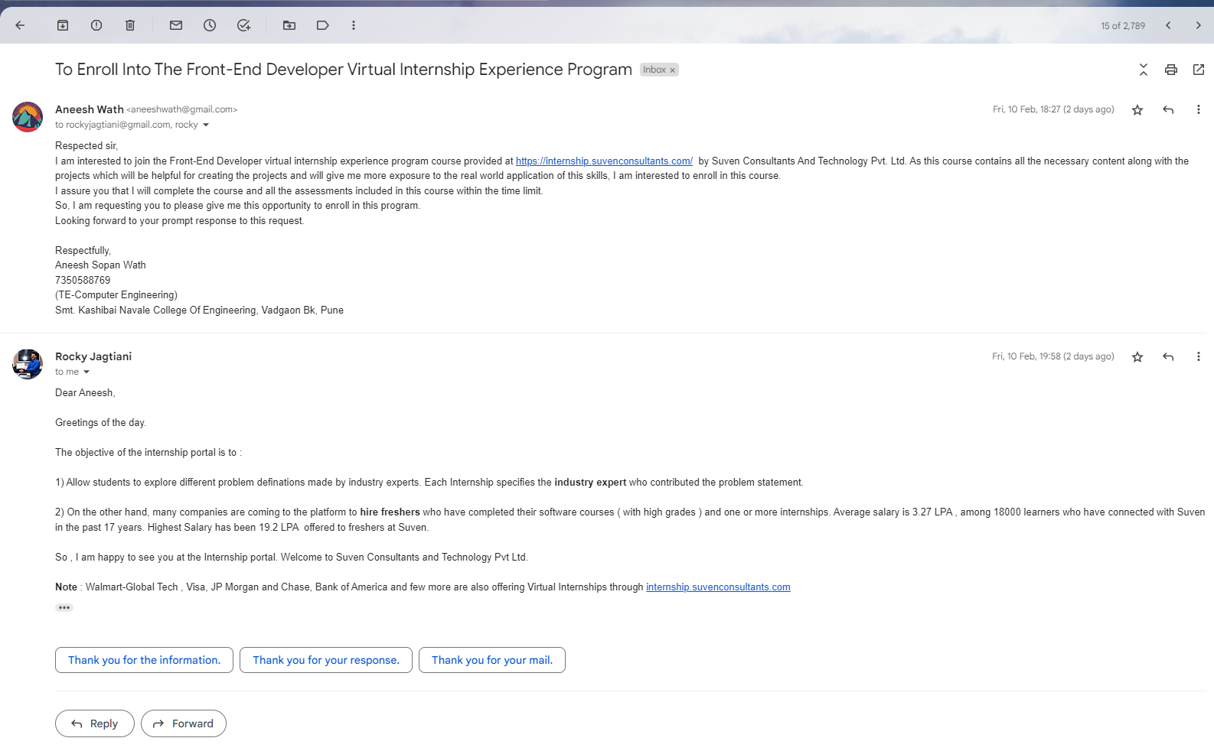
Details of Company

Slide 5
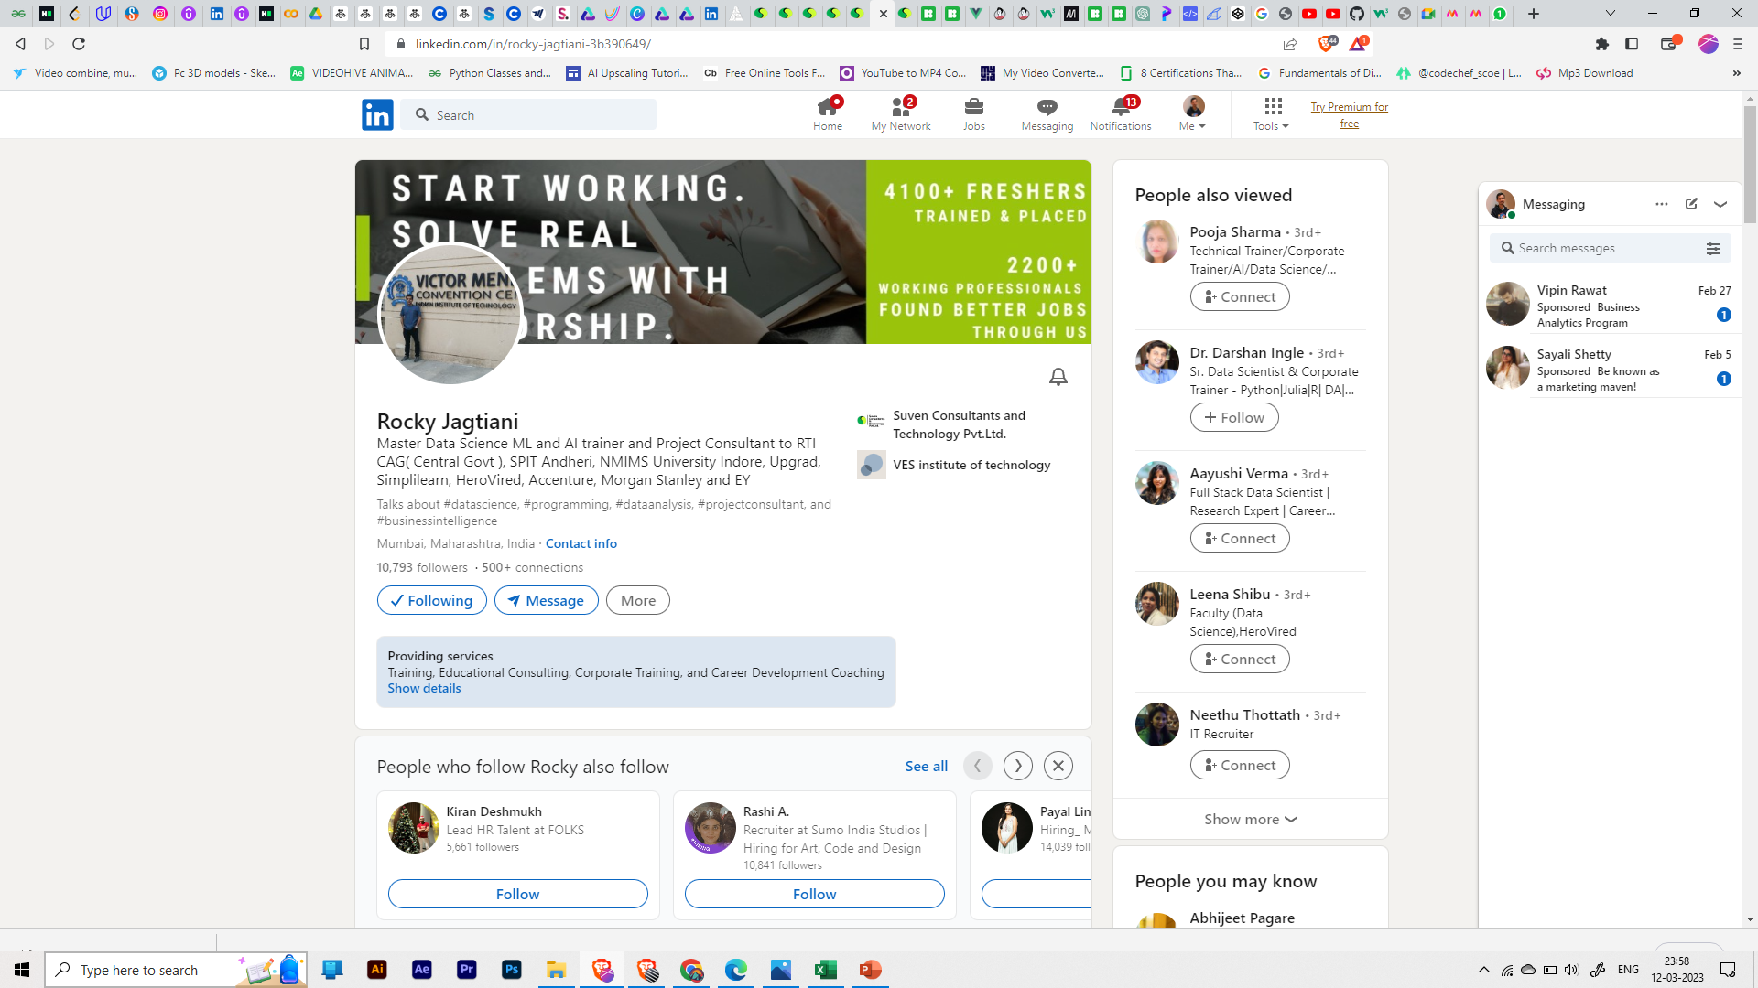
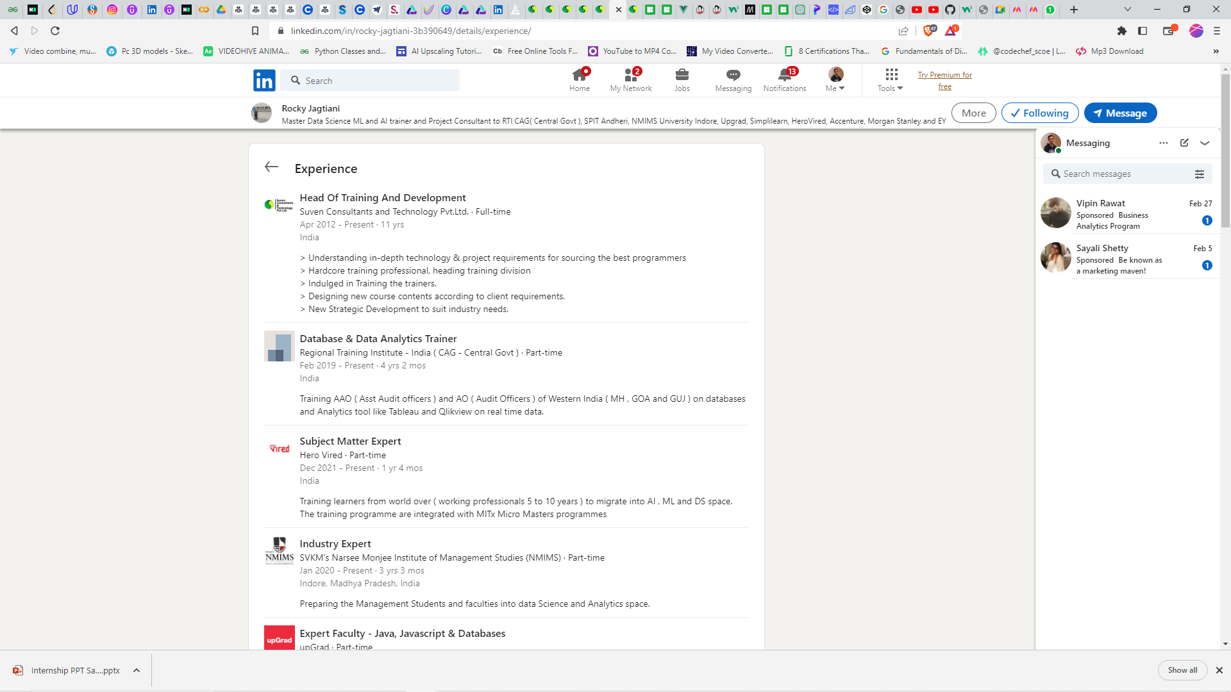
Details Of External (Company) Mentor

Slide 6
Details Of External (Company) Mentor
Mr Rocky Jagtiani has 22 years of training experience in Open Source Technologies like Java, Python, JavaScript, Databases & Machine learning. He is mentor to many top engineering colleges for training faculties through FDP's and Bootcamps. He is empaneled as a freelance Corporate trainer with 17 IT MNC's in India. He is a Subject Matter Expert on Data Science , Programming and Databases with Upgrad, Simplilearn, Herovired and knowledgeHut. Has trained more than 15000 young working professionals(0-6 years Work Experience) till date and helped many in career switch.

Slide 7
About Internship
Problem statements
Objectives
Scope
Methodology
Work done till date

Slide 8
Problem Statements/Projects
Create An Admin Dashboard
Create A Responsive Restaurant Website.
Create A Responsive Portfolio Website.
Build A Fullstack React Ecommerce App that is fully responsive with Stripe Payment.
Every project must be completed along with an assessment exam, which must be passed with a minimum score of 80% in no more than two attempts.

Slide 9

Project Objective
Get Familiar with the practical application of subject
Web-Technology
Build real-time website interfaces
Make the website responsive so that it can support any device.
Study the fundamental things along with the assessment test.

Slide 10
Scope of Front End Development
Proven work experience as a Front-end developer
Hands on experience with markup languages
Experience with JavaScript, CSS and jQuery
In-depth understanding of the entire web development process (design, development and deployment)
Understanding of layout aesthetics
An ability to perform well in a fast-paced environment
Excellent analytical and multitasking skills

Slide 11
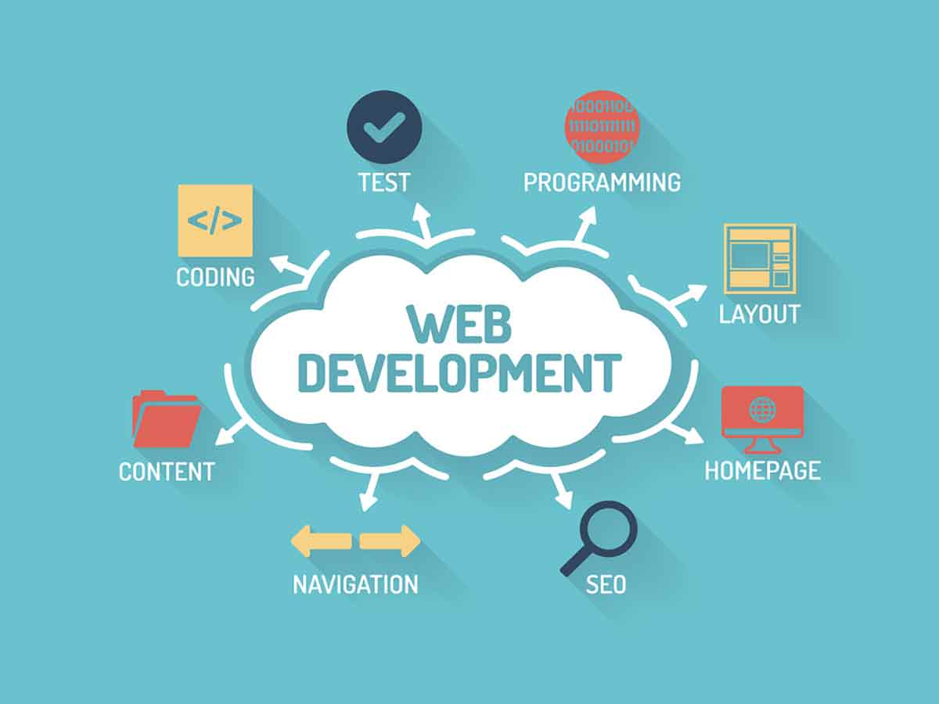
Methodological Details
HTML
CSS
JAVASCRIPT
React.js
Strapi (Headless CMS)
Documentation (Report Making)

Slide 12
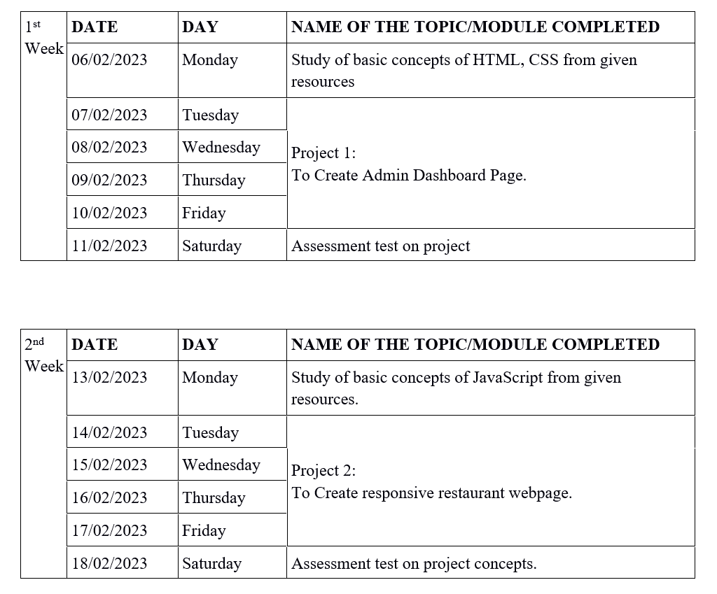
Weekly overview of internship activities:

Slide 13
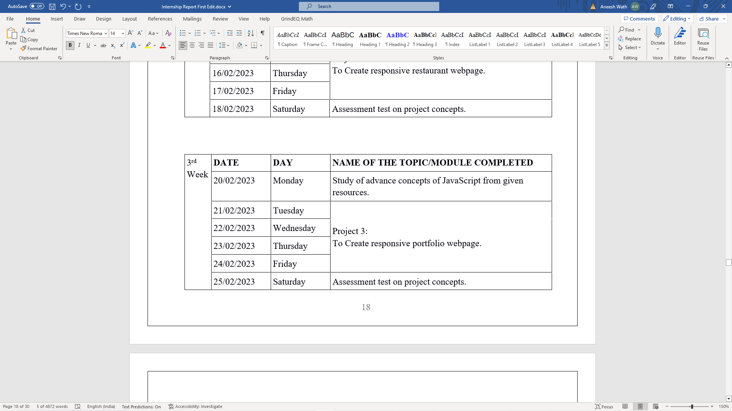
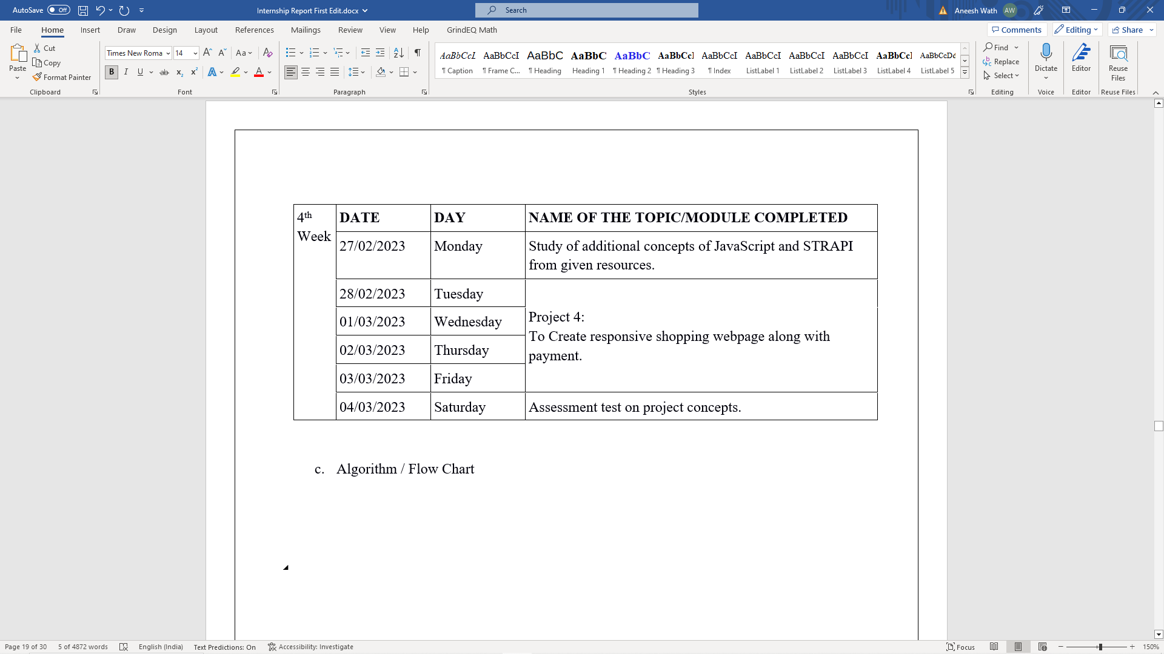
Weekly overview of internship activities:

Slide 14
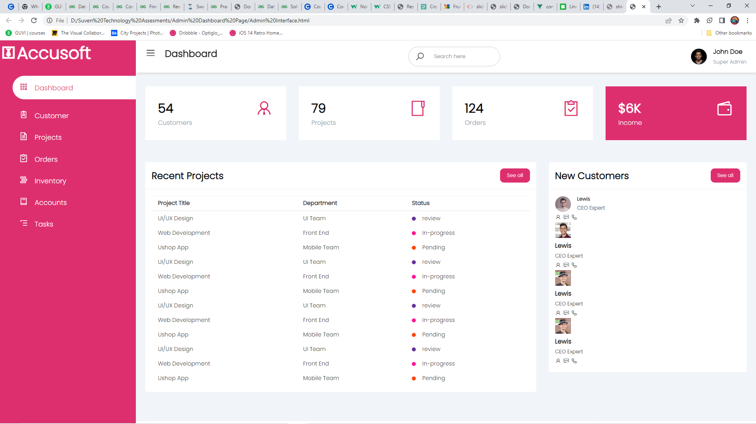
Project Preview:
All projects are complete with assessment test.
Report of the projects completed.
Studying into the depth of the structure of every project.
Preview Of 1st Project

Slide 15

Project Preview:
Preview Of 2st Project

Slide 16
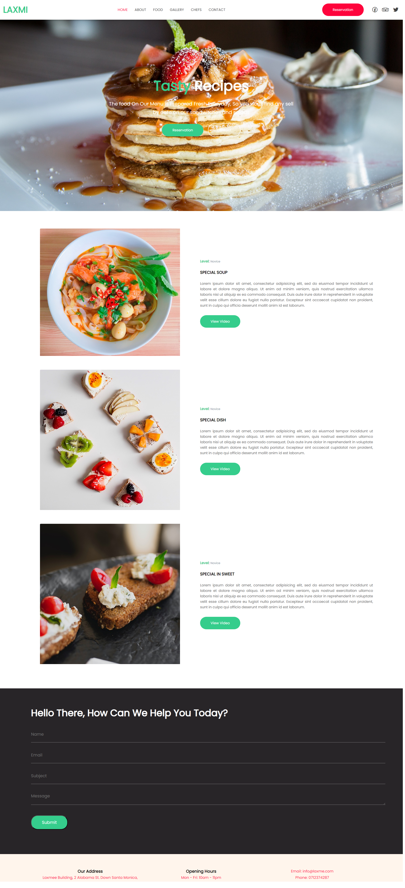
Project Preview:
Preview Of 2st Project

Slide 17
Project Preview:
Preview Of 2st Project

Slide 18
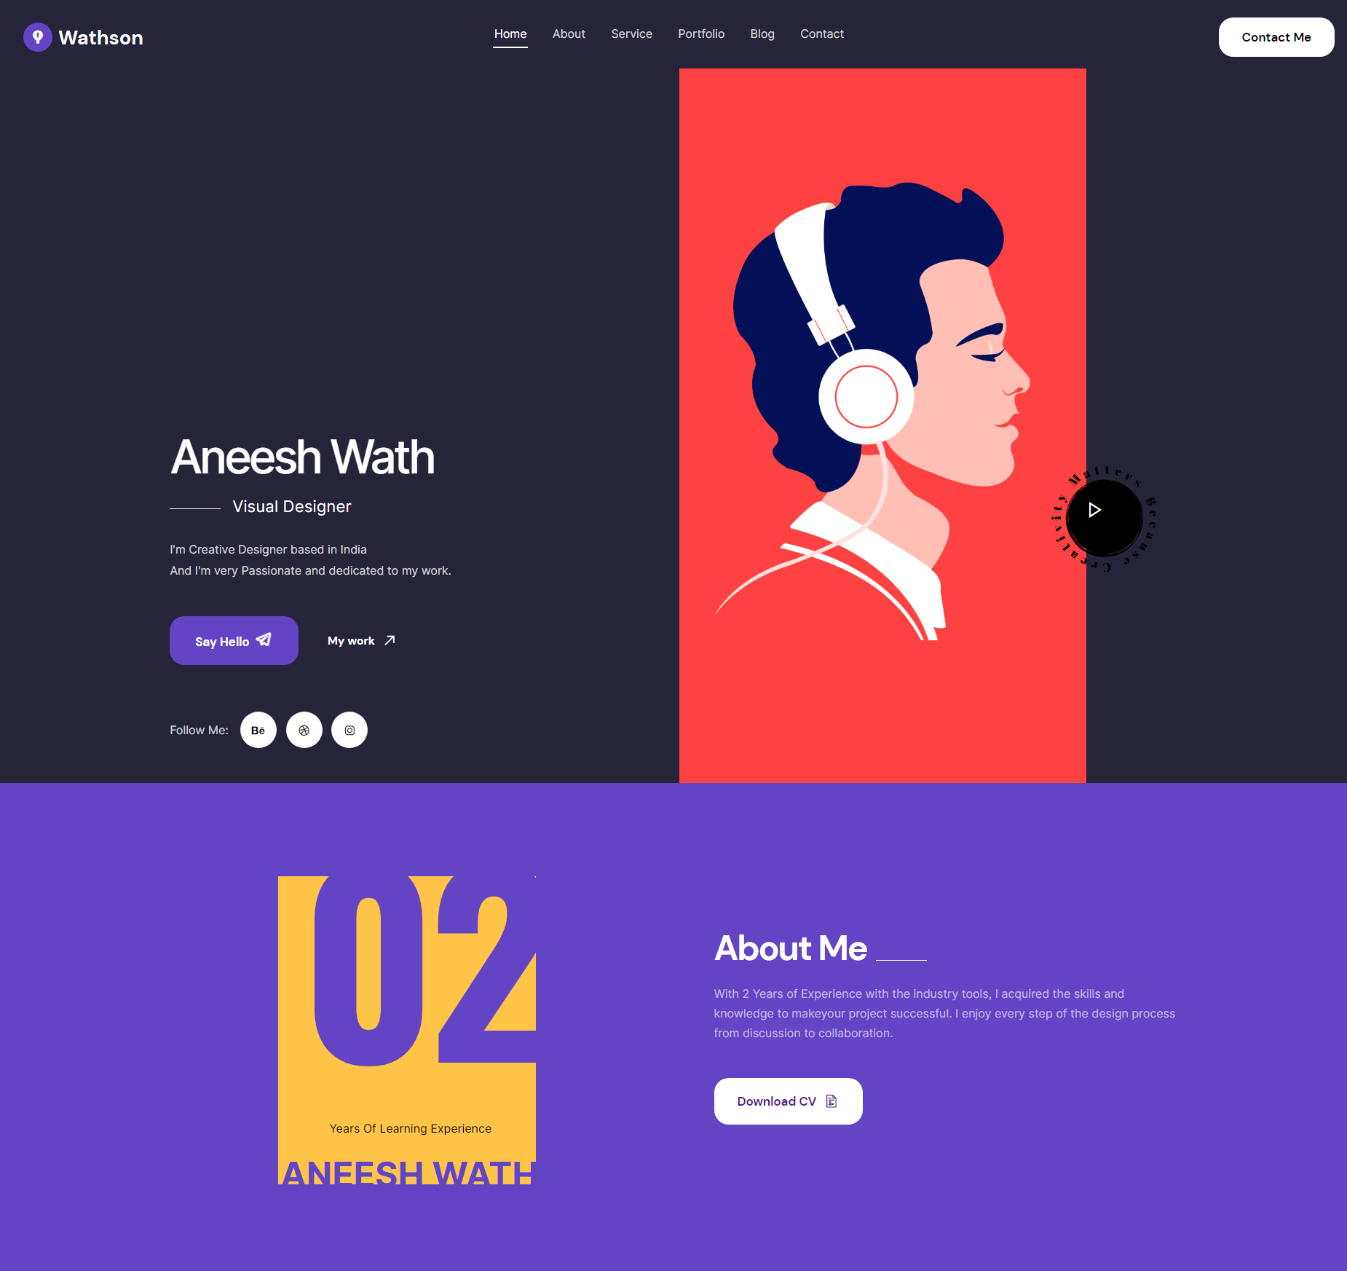
Project Preview:
Preview Of 3rd Project

Slide 19
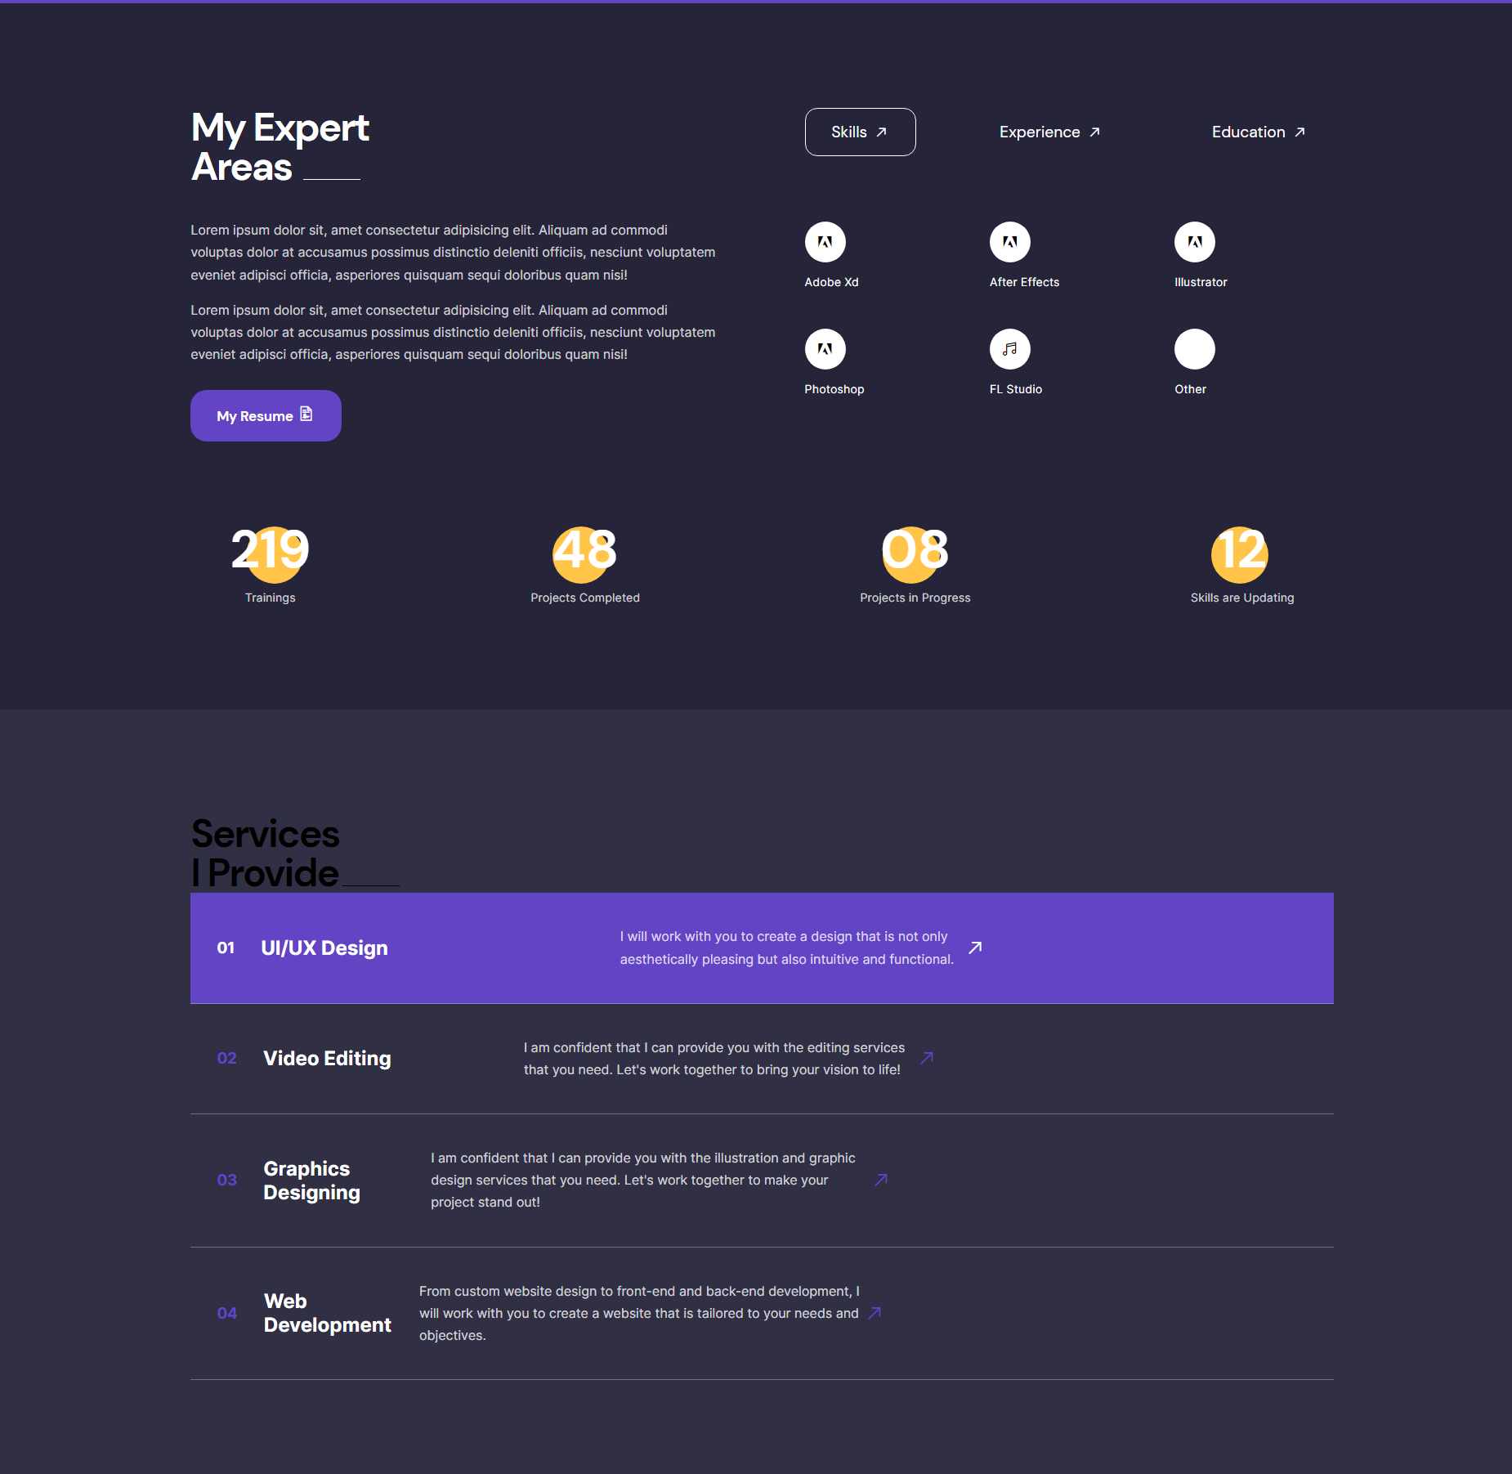
Project Preview:
Preview Of 3rd Project

Slide 20
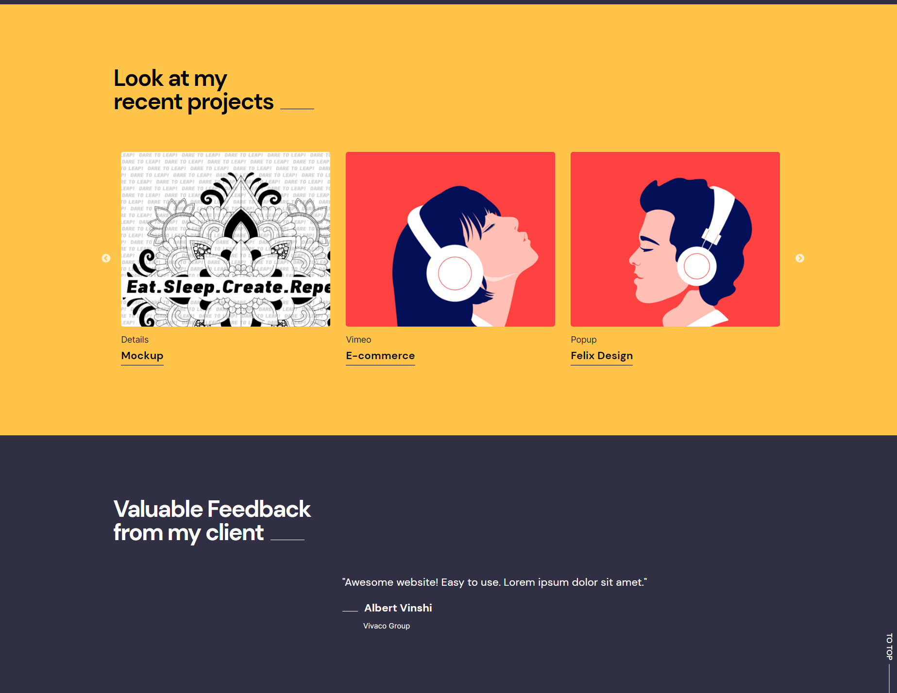
Project Preview:
Preview Of 3rd Project

Slide 21
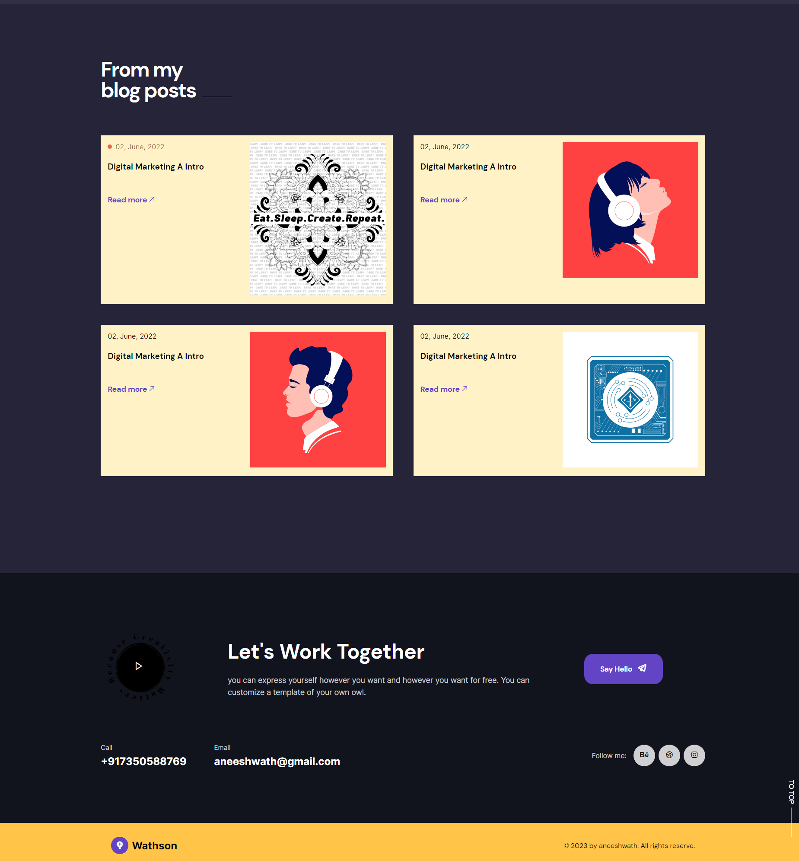
Project Preview:
Preview Of 3rd Project

Slide 22
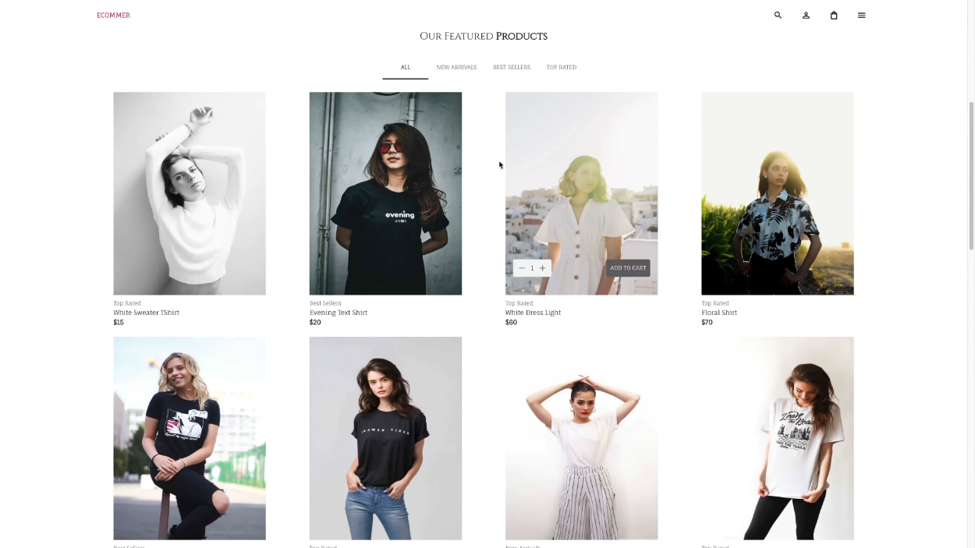
Project Preview:
Preview Of 4th Project

Slide 23
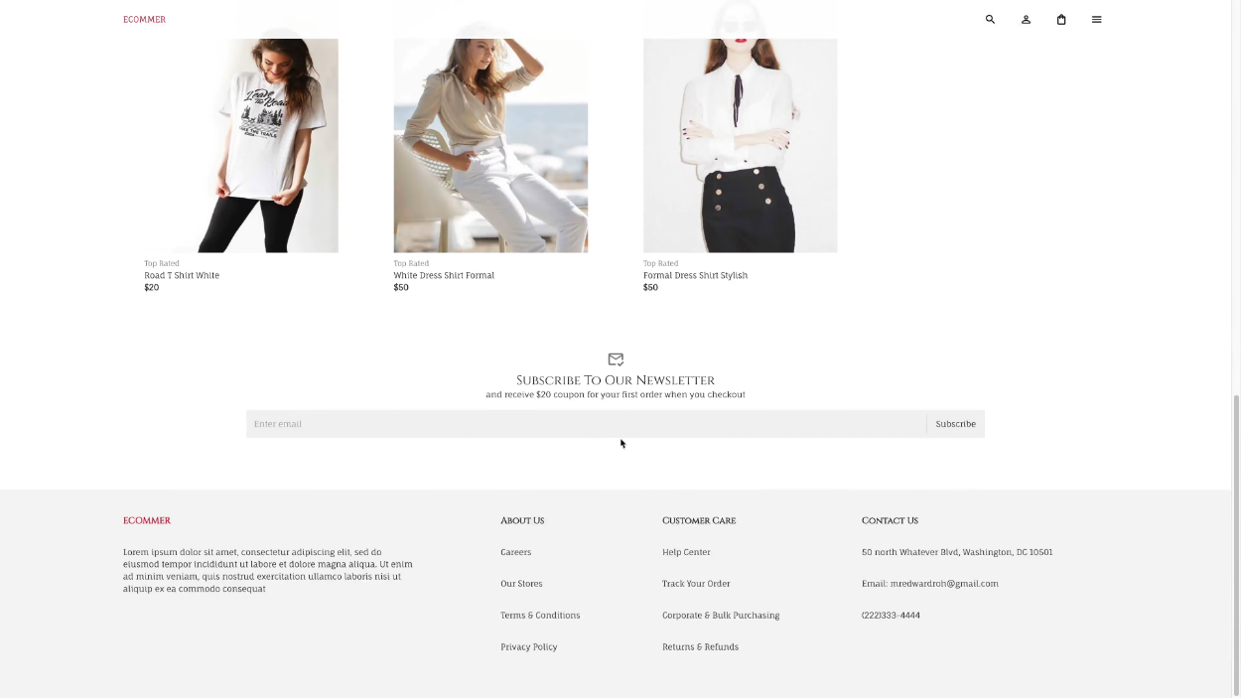
Project Preview:
Preview Of 4th Project

Slide 24
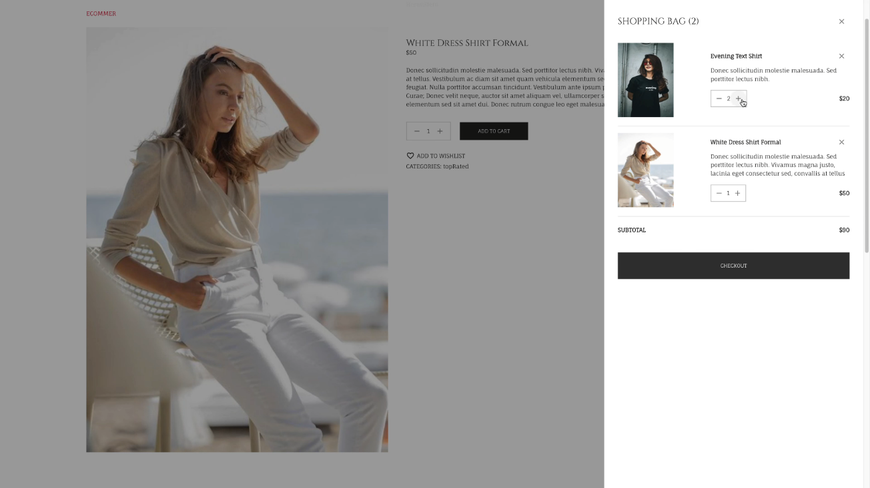
Project Preview:
Preview Of 4th Project

Slide 25
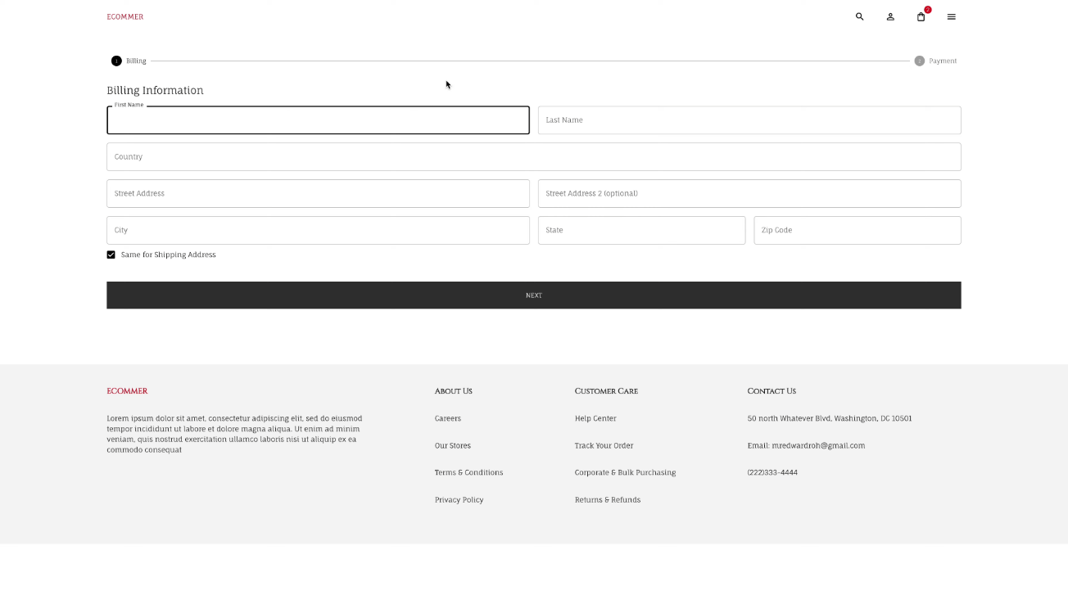
Project Preview:
Preview Of 4th Project

Slide 26
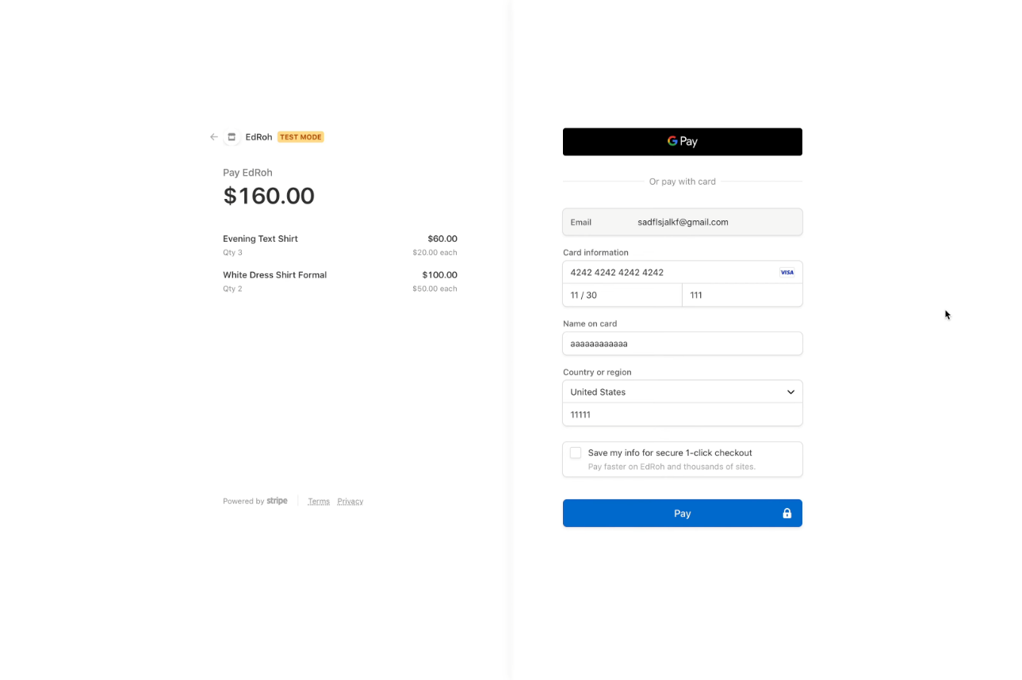
Project Preview:
Preview Of 4th Project

Slide 27
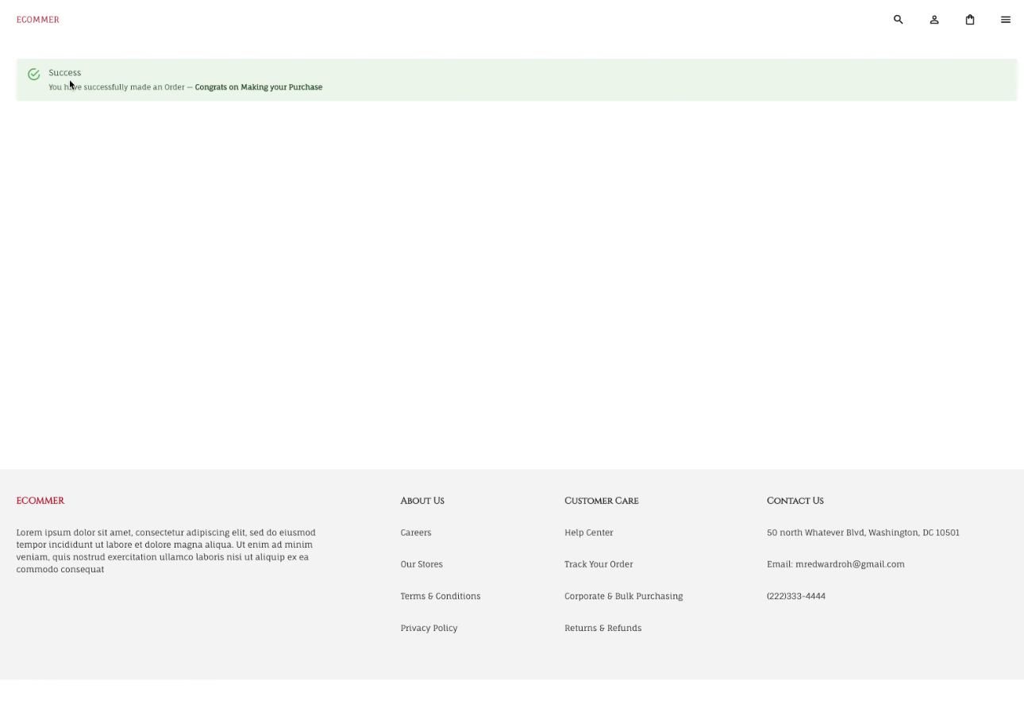
Project Preview:
Preview Of 4th Project

Slide 28
Conclusion
My Front-End Web Development Internship at Suven Consultants and Technologies was an incredibly rewarding experience that allowed me to learn and develop skills in a variety of areas. Throughout the course of the internship, I worked on four different projects, each with its own set of challenges and learning opportunities. It was an excellent opportunity to gain practical experience in building web-based applications and develop proficiency in using various web development tools and technologies.

Slide 29
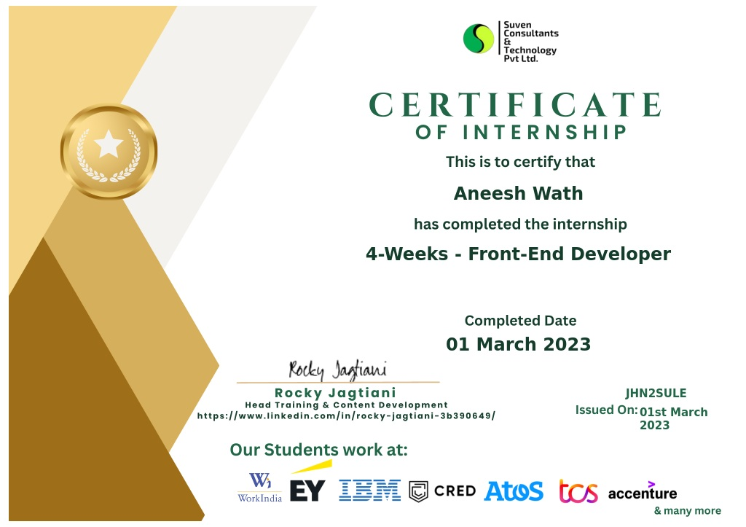

Slide 30
Thank you for your Attention!

